Slide 1
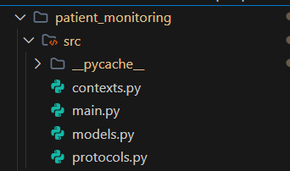
Patient Monitoring System Using Model Context Protocol (MCP)
About the Project:
This system was successfully developed and implemented to simulate real-time patient monitoring.
Designed to track vital health signs like temperature, heart rate, oxygen saturation, and blood pressure.
Built using the Model Context Protocol architecture for clean code separation and maintainability.
System Layers (MCP):
Protocols: Interface definitions (e.g., PatientDataProtocol, AlertProtocol)
Models: Core logic (PatientMonitor) for validating vitals, assessing health, and triggering alerts
Contexts: Concrete implementations like ConsoleAlertSystem and InMemoryStorage
Language Used: Python
Folder structure

Slide 2
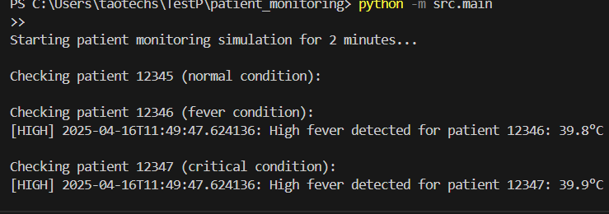
BENEFITS, FEATURES AND Next steps
Why MCP Was Effective:
Modular Design: Easily swap components like storage.
High Testability: Mockable protocols for unit testing.
Extendable: Add new features without affecting existing code.
Key Features Implemented:
Multi-patient monitoring with real-time simulations.
Configurable intervals and alert system.
Future Enhancements:
1. Database integration
2. REST API support
3. Machine learning alerts
4. Real-time streaming and mobile alerts
Conclusion The Patient Monitoring System showcases MCP’s strength in creating flexible, scalable, and production-ready healthcare solutions.
Simulations

